Slide 1
Change, Not Charity: The Giving Project

Slide 2
Agenda
Introductions
Chinook Fund
Change, not Charity
The Giving Project
Hear from our Alumni: Ky and Brian
How to apply
Stay Connected
Notes:
PBJ

Slide 3
WHO'S ON THE CALL
Share the following in the chat box:
My Name Is
Your Name
Gender Pronouns
How did you get connected to us?
If you’re joining from a computer, please hover over your image and click on the 3 dots in the top right corner to rename yourself your first & last name andgender pronouns
Notes:
PBJ

Slide 4
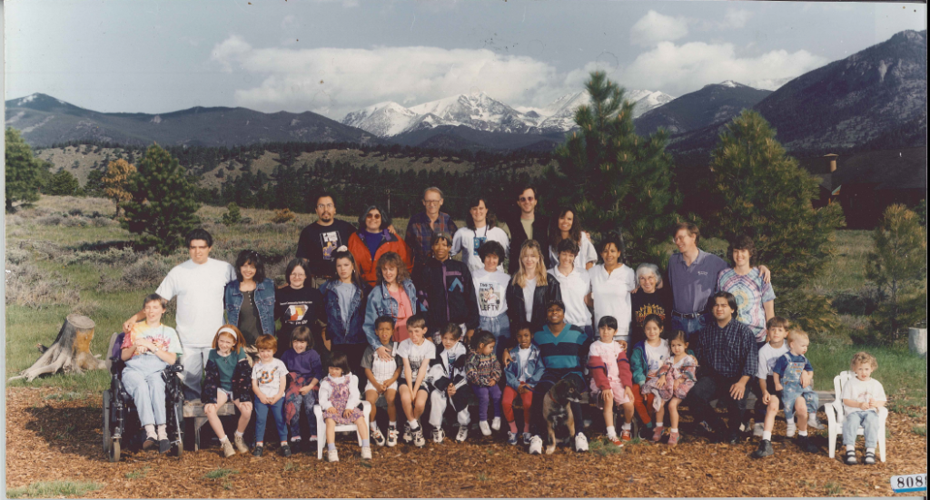
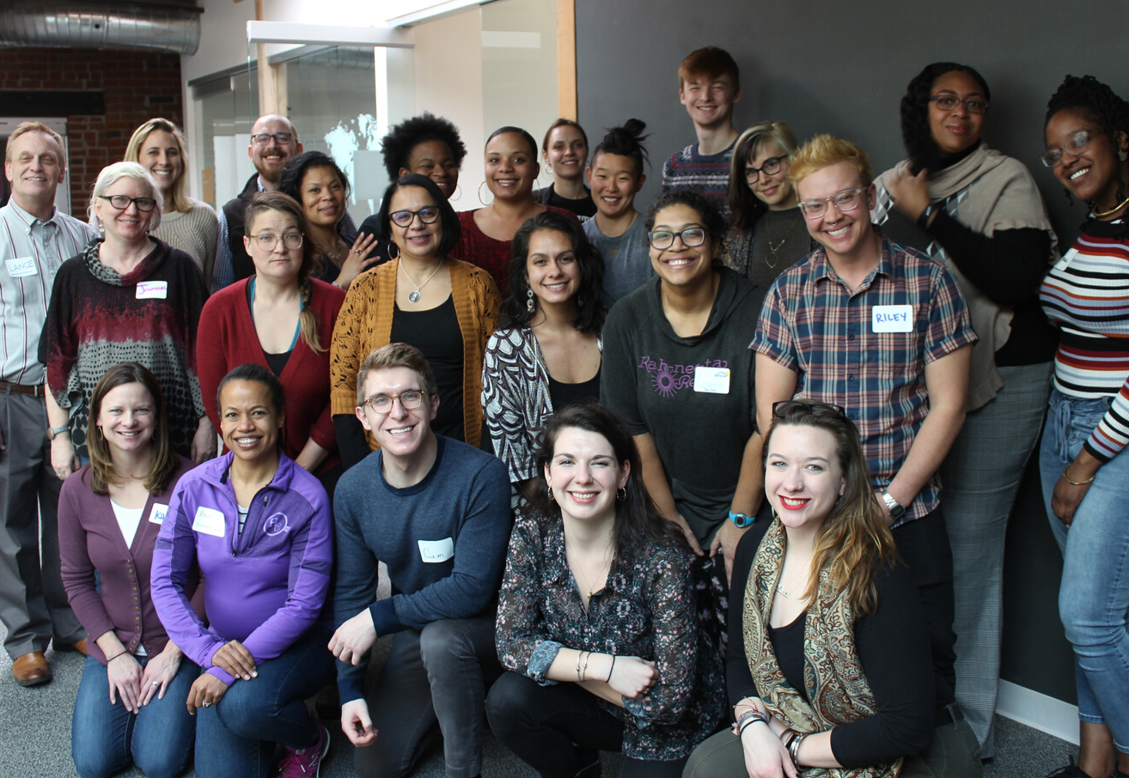
Our History
SINCE 1987 - CHANGE, NOT CHARITY
Funding Exchange
Grantmaking Committee
Giving Project
Notes:
SJL

Slide 5
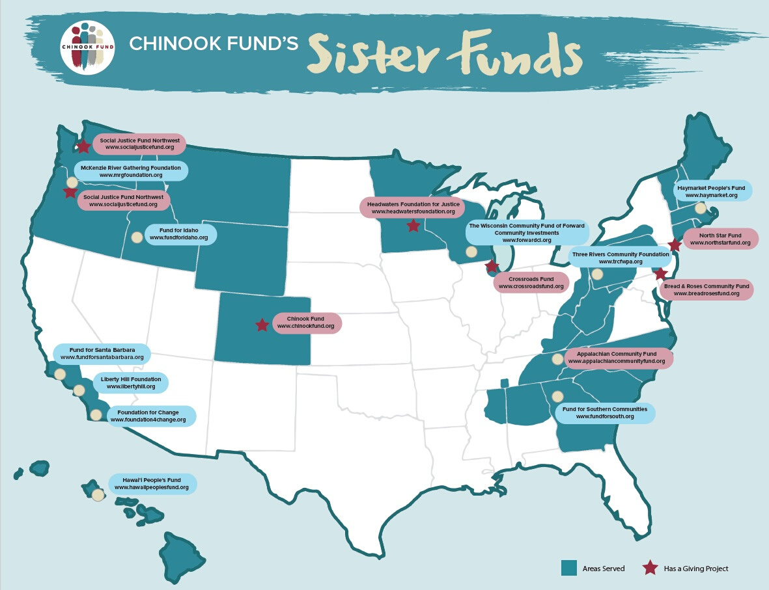
Our History
SINCE 1987 - CHANGE, NOT CHARITY
Notes:
SJL

Slide 6
Our Mission
Chinook Fund supports grassroots organizations working on issues of social and economic justice; by pooling our collective resources, we seed groups making a positive, systemic impact to improve the quality of life for all Coloradans.
Notes:
PBJ

Slide 7
Our Values
Liberation
Community
Integrity
Leadership
Notes:
PBJ

Slide 8
FUNDING CRITERIA
How our Giving Project volunteers evaluate applicants
Constituent-Led
Community-Wide
Lasting Effect
Work is led by the people most impacted by the injustice. we believe that those most affected by injustice have the vision and solutions for their own liberation.
Intersectionality.
Work reflects all members of the constituency and community - particularly those who experience multiple forms of oppression.
Works makes meaningful change for the community as a whole and for future generations (not just one individual in the immediate future).
Notes:
SJL

Slide 9
FUNDING PRIORITIES
How our Giving Project volunteers evaluate applicants
Rural Organizations
Special consideration is given to groups based outside of the Front Range (not in Denver, Boulder, Colorado Springs, or Fort Collins).
Community Organizing
The process of bringing affected people together to use their collective power to win improvements in their community and change the power structure to advance social justice.
Based in CO with a budget under $350K
Notes:
SJL

Slide 10
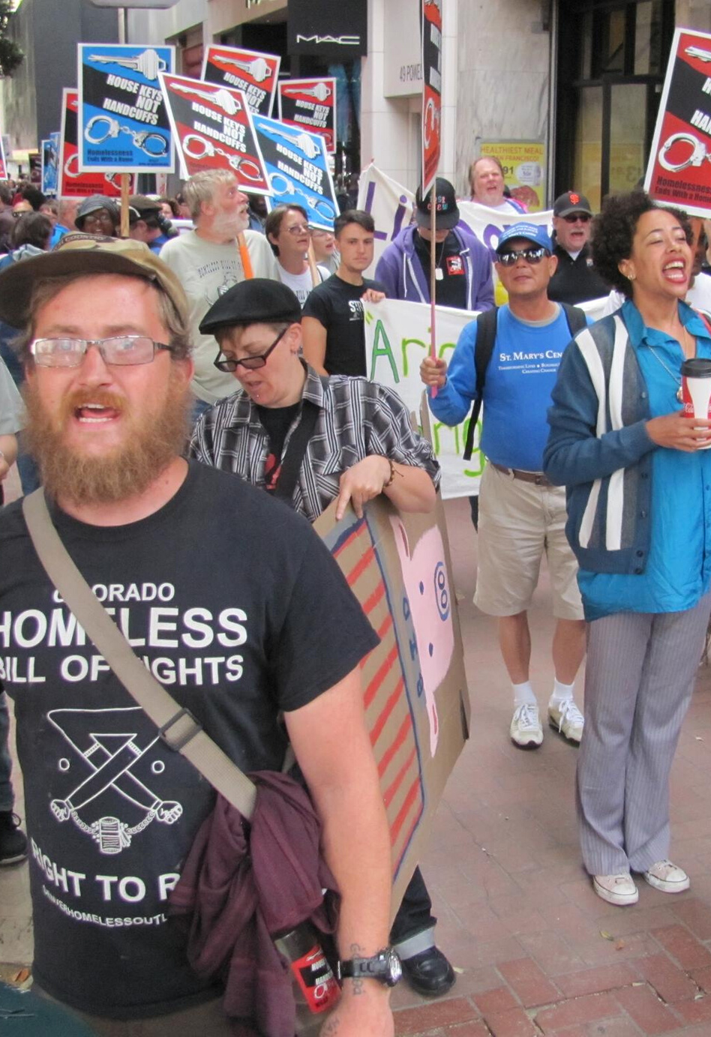
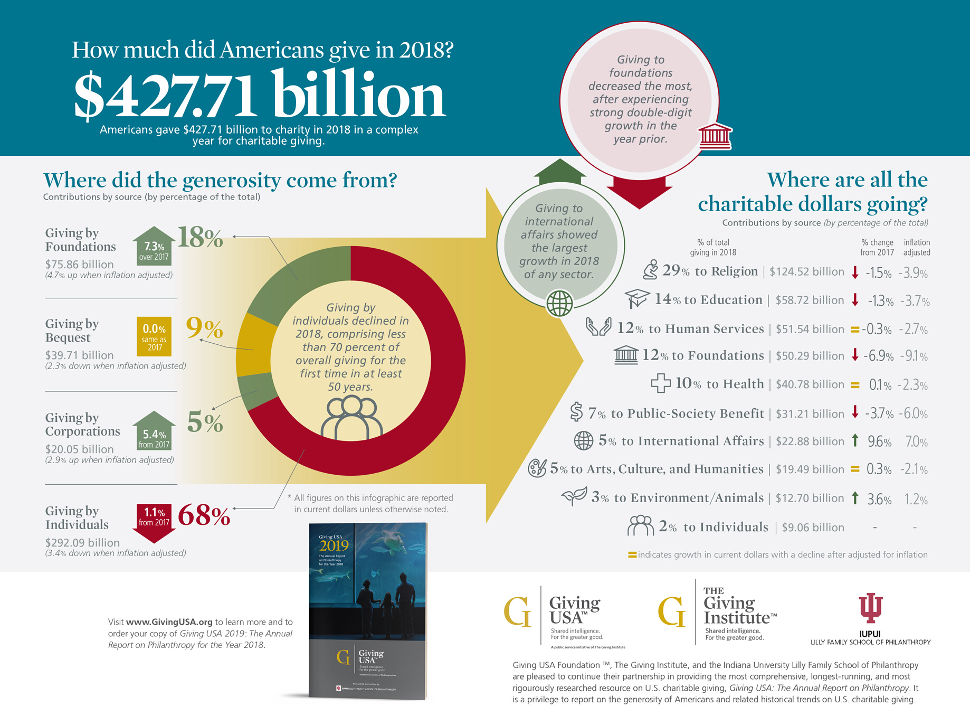
We need change, not charity
Notes:
PBJ

Slide 11
Small Group discussion
After learning more about our history and work, what does change, not charity now mean for you?
Why do you wish to get involved with us at this time?
Notes:
SJL

Slide 12
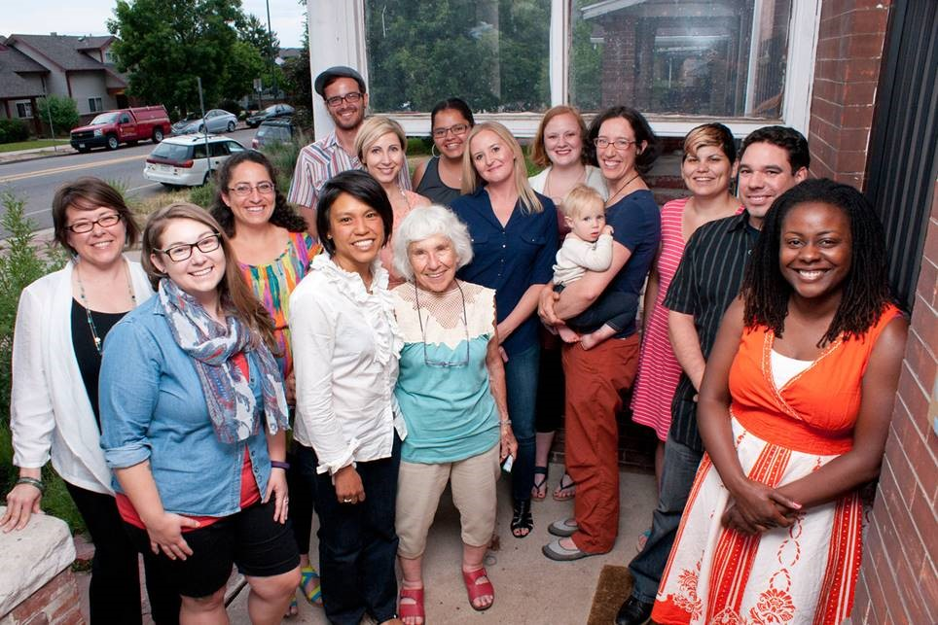
THE GIVING PROJECT
How we build community leadership and resource social change in Colorado
The Giving Project brings together a diverse cohort of people from all income levels who are passionate about social change and interested in developing new skills in fundraising, grantmaking, and community building.
Notes:
SJL

Slide 13
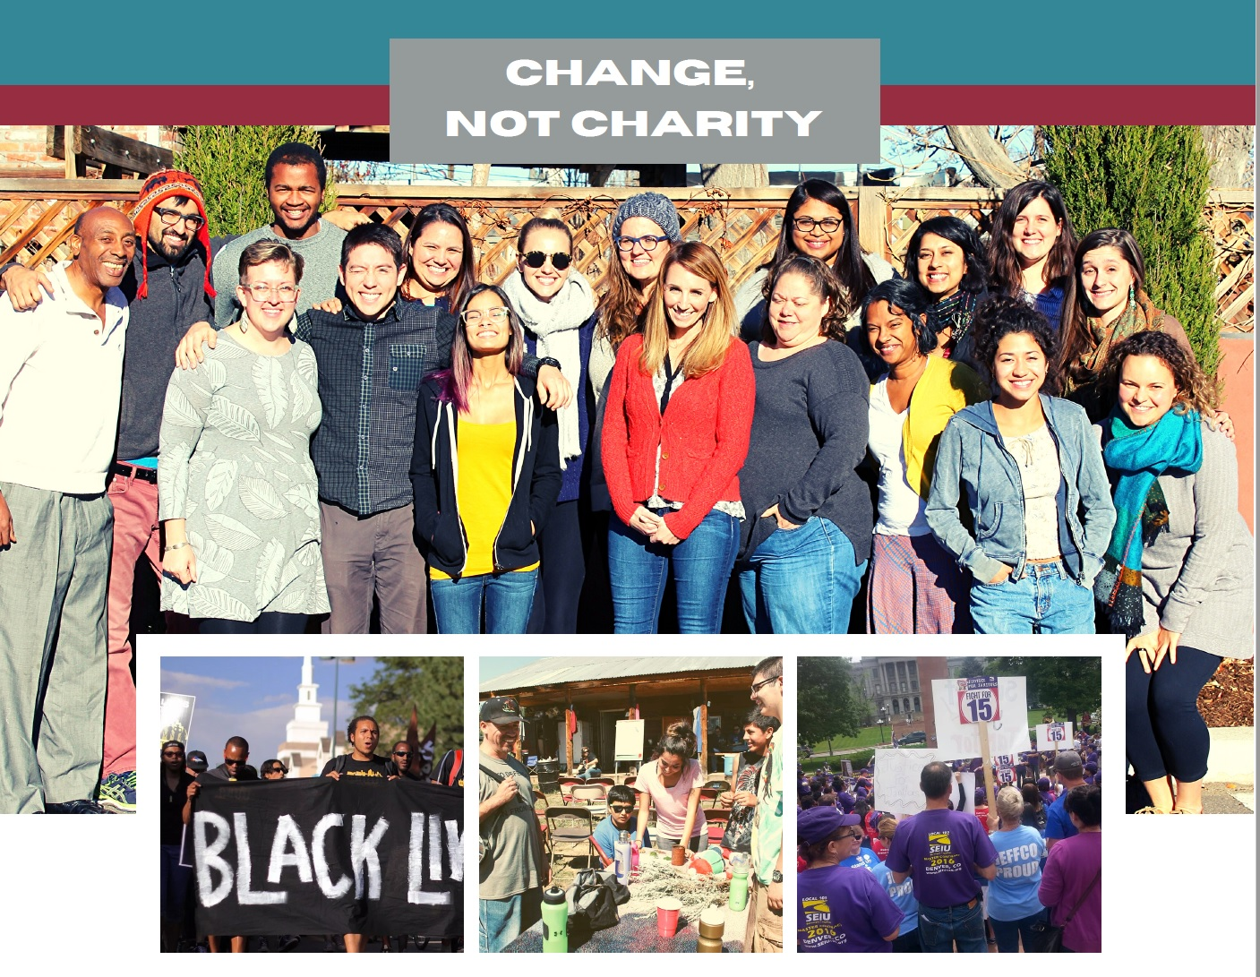
Giving Project Cycle
12 meetings over 6 months
Optional external caucuses
Optional online meetups for grant review
Fall: Sept-March
Spring: January - June
Approximately 100 hours
40 in online meetings
60 for individual work

Slide 14
THE GIVING PROJECT
Leadership and accountability through racial justice practice
Phase 1
Phase 2
Phase 3
Community building & political education
Skill building
Action
outreach, fundraising, grantmaking
Notes:
PBJ

Slide 15
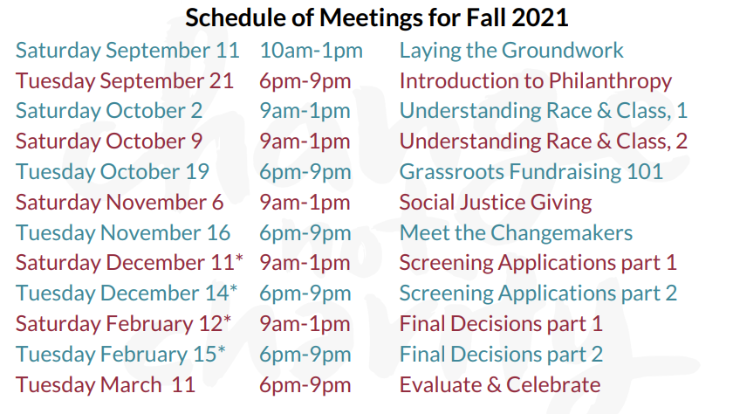
Notes:
PBJ

Slide 16
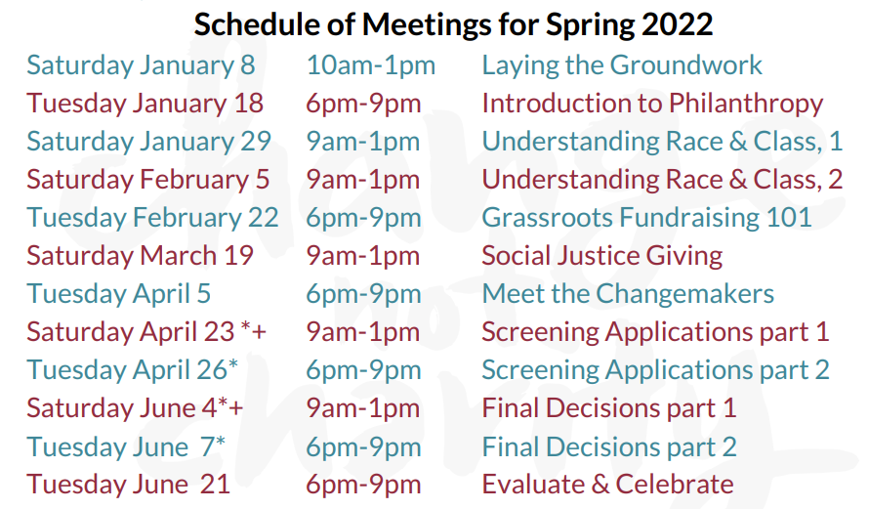
Notes:
PBJ

Slide 17
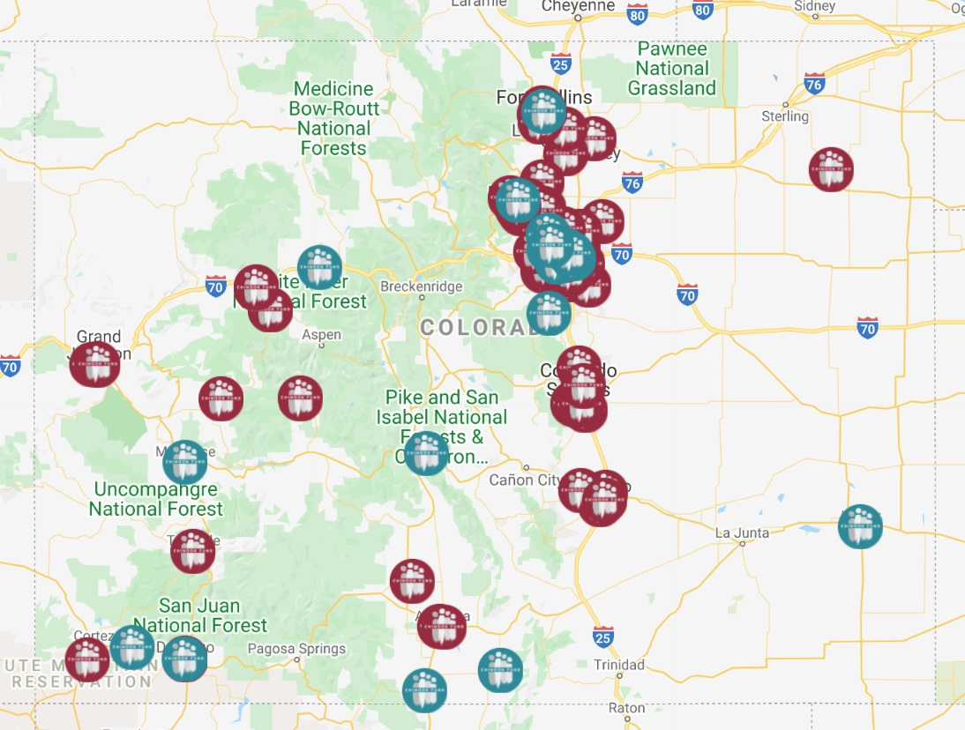
CHINOOK FUND'S GIVING PROJECTS
Outcomes
151
Members
$729K
Dollars Raised
80+
Groups Funded
Notes:
SJL

Slide 18
COVID-19 Response
All meetings on Zoom and < 4 hours*
Site visits will be digital
Childcare and meal reimbursement
Technology accessibility including wifi
hotspots & loaner laptops
We hope to be able to begin meeting safely in large groups in April 2022
Notes:
SJL

Slide 19
Giving Project Goals
Move significant money to social justice organizing in Colorado
Build community
Educate ourselves about the current challenges and potential of social justice organizing around these issues--through an anti-racist lens
Develop our skills as donor organizers
Create a sustainable new model of funding critical, underfunded social change work
Notes:
PBJ

Slide 20
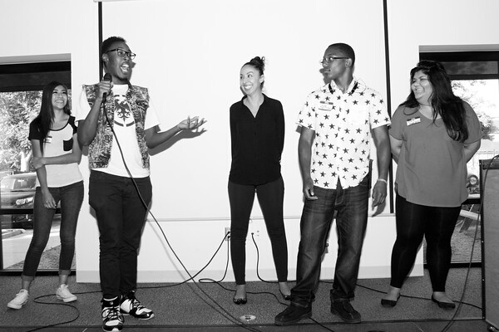
Giving Project Commitments
Willingness to grow and learn
Attend all the sessions
Make a personal donation
Fundraise
Review all grant materials
Make at least 2 site visits
Report your findings
Offer us feedback
Notes:
SJL

Slide 21
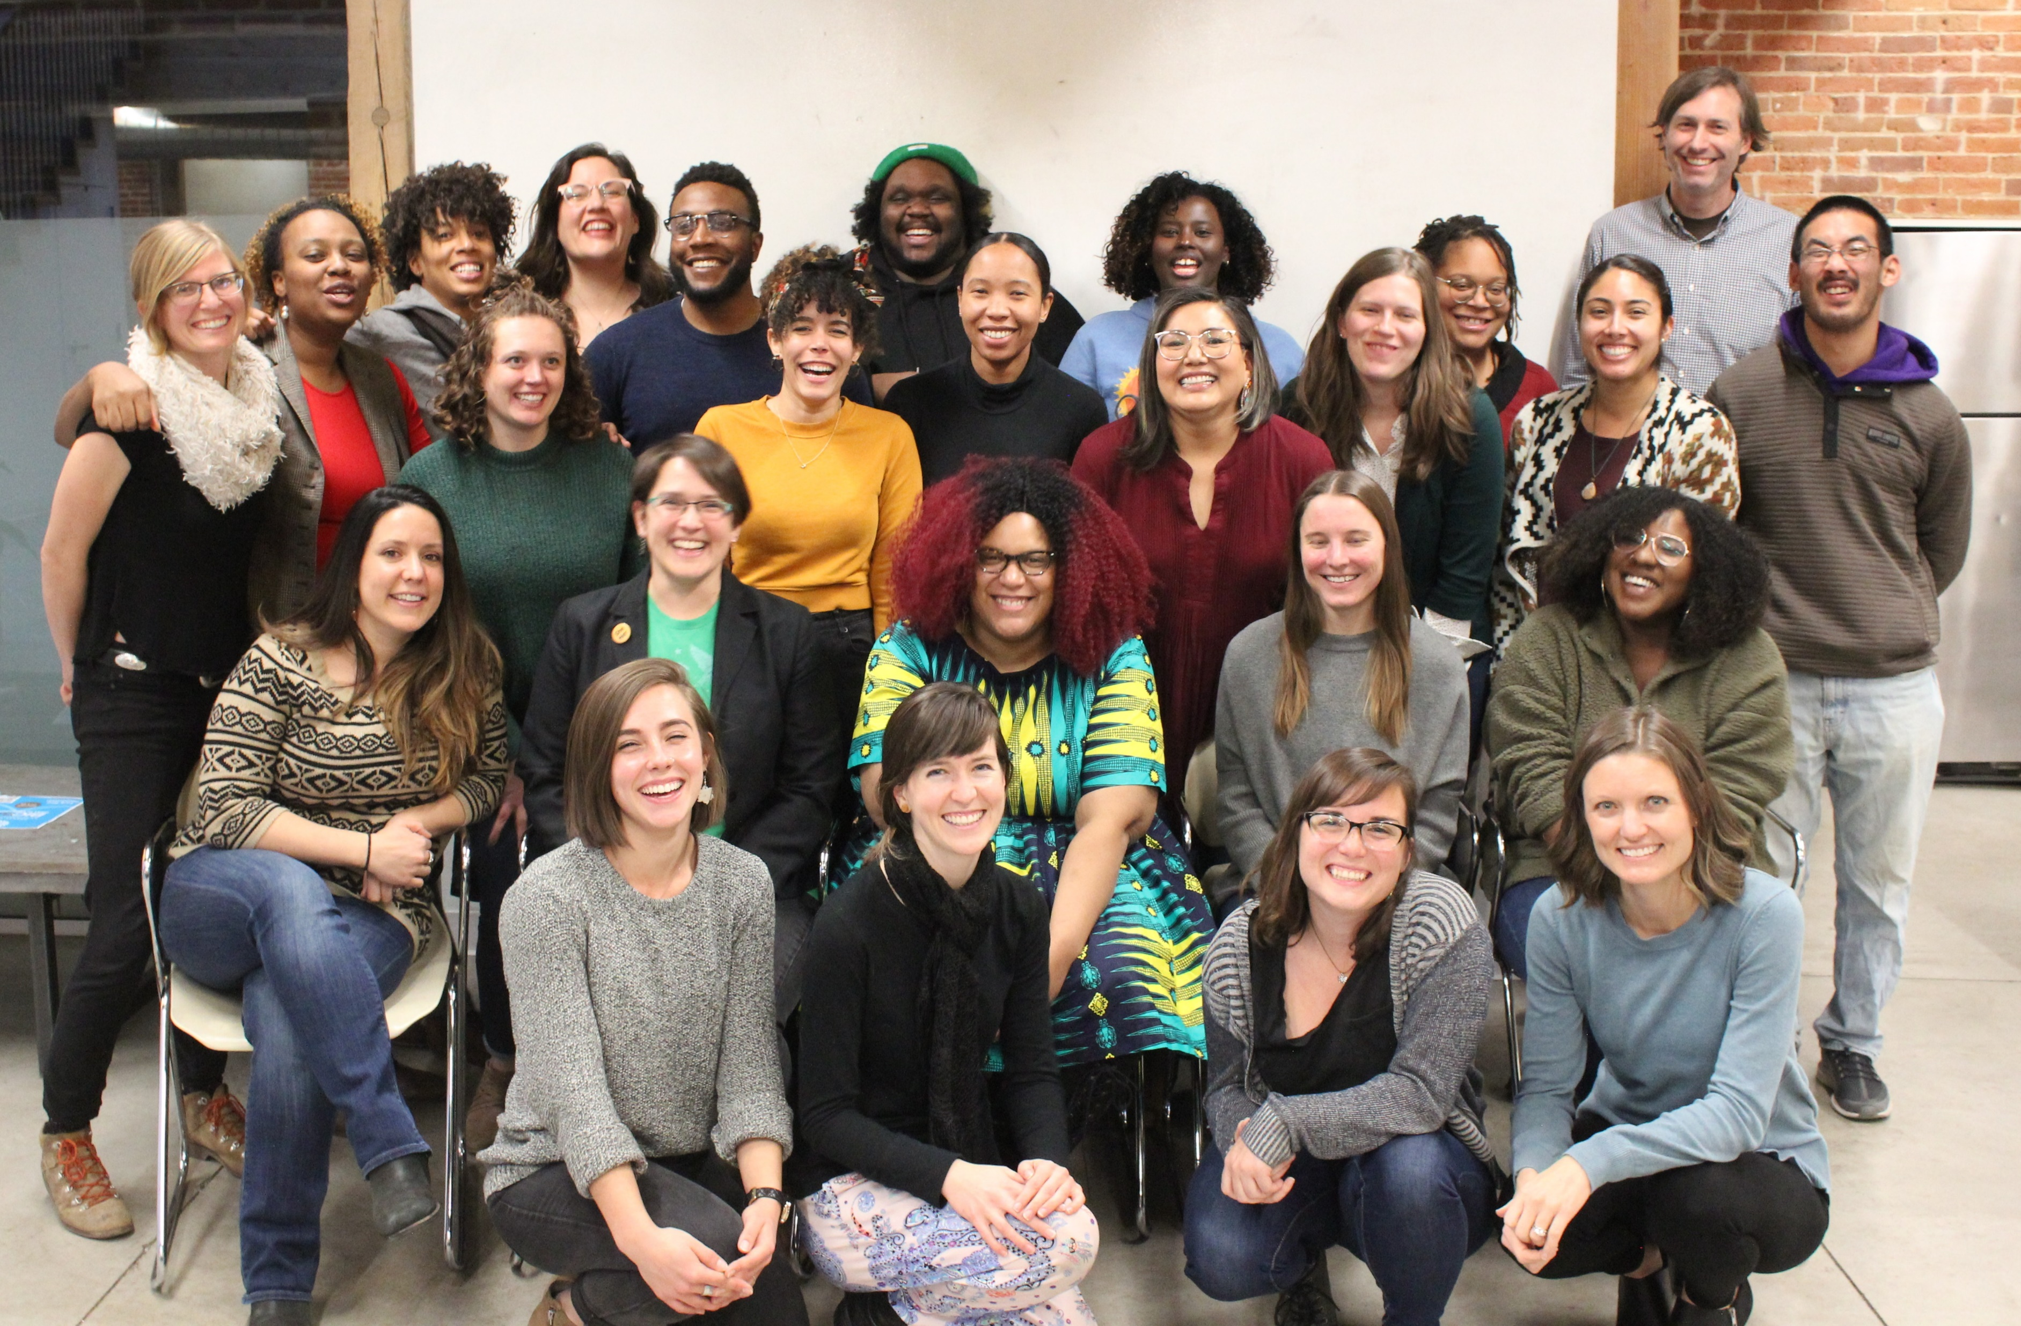
Chinook Fund’s Commitments
Work with the group to create an inclusive space
Organize all logistics
Coordinate all trainings
Thoughtfully build agendas – we respect and value your time
Support grantmaking and fundraising efforts
Accept feedback – especially feedback that can lead to change
Staff are here as resources for the project and for the members

Slide 22
Chinook Fund: Other Logistics
There is no fee to join. All members make a donation to the grant fund, but do not pay to join or participate in the program
Chinook Fund retains 15% of the fundraised pool as a Program Fee to offset organizational costs associated with The Giving Project
Facilitator compensation (1.75 staff with benefits, 2 contracted facilitators). Program Director salary has been $56k for 3 years.
Accessibility support (childcare, meal reimbursements, tech access)
Stipends for interns & organizational leaders to share their expertise
Digital and printed materials

Slide 23
Join a National Movement for Change
Giving Projects and partner social justice funders across the country
There are Giving Projects in
Boston
New York
Philadelphia
Minneapolis
Chicago
Seattle
Portland
Denver
Honolulu
Detroit
North Carolina

Slide 24
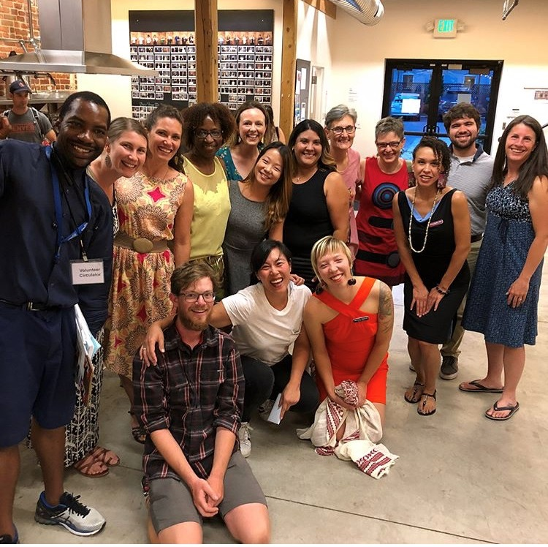
Chinook Fund’s Alumni Network
Anti-racism support spaces (Community Caucuses)
Ongoing learning opportunities
Community Wealth Building panel
Ethical Communication workshop
Hot spots in contemporary organizing
Community celebrations

Slide 25
Giving Project alumni testimonials:
“The caucus was surprisingly insightful
and deep. Discussion around centering anti-black racism was very challenging
and helpful.”
“Thank you for this training--it is
changing my life! You are empowering me to own my power. Change, Not Charity.”
Spring 2019 Giving Project cohort members
Notes:
SJL

Slide 26
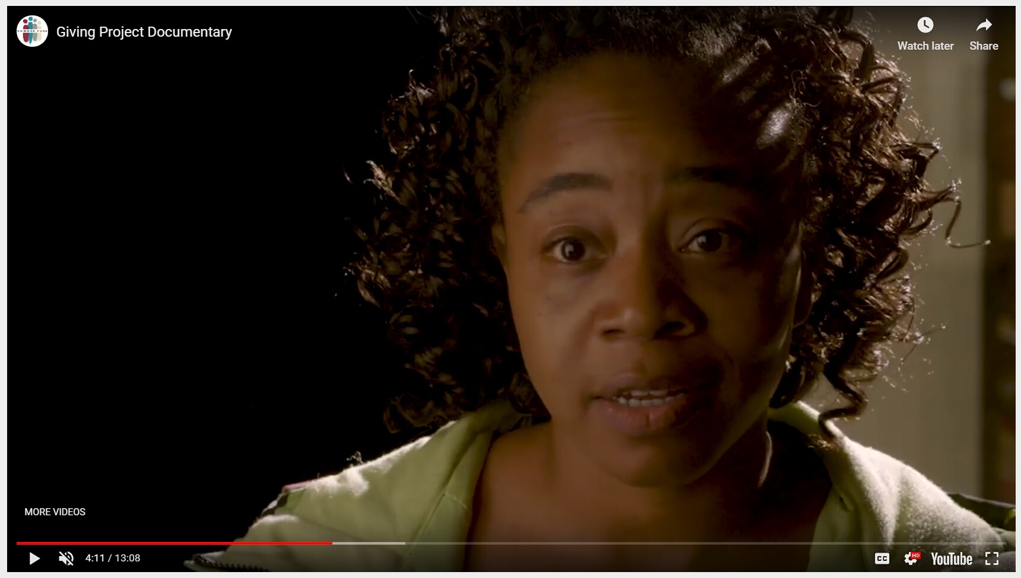
LEARN MORE: THE GIVING PROJECT
https://www.youtube.com/watch?v=vwMulkx8AsU
Notes:
PBJ

Slide 27
How do I join?
1. Apply Online 2. Interview 3. Stay Connected
We accept applicants on a rolling basis using an equity framework. Depending on our applicant pool, you could be accepted immediately or placed on a wait list up until our first Giving Project meeting.
Notes:
SJL—screen share and show them the webpage

Slide 28
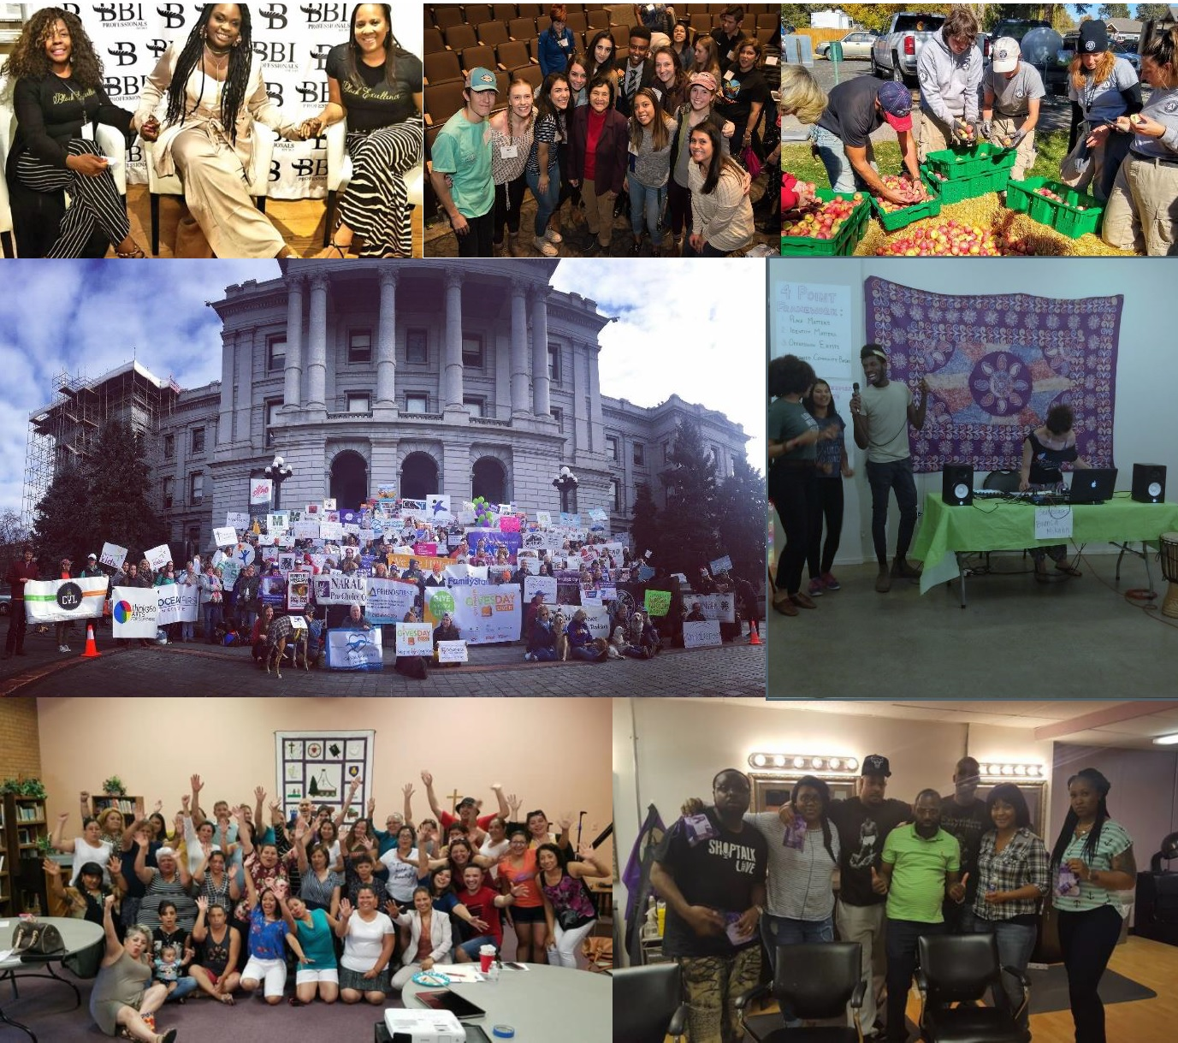
Stay Connected
Join our monthly digital newsletter, Seed Notes, and visit our website to learn more about our Grantees
Notes:
PBJ

Slide 29
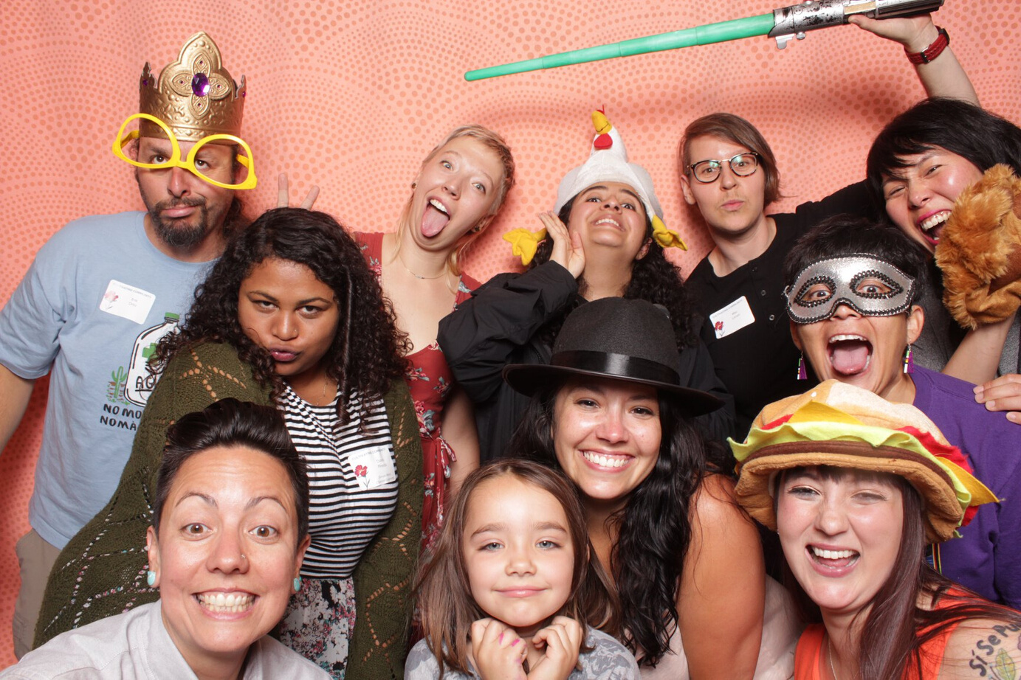
Questions? Thank you for attending!
Email Address
Barclay Jones, Program Manager
pbjones@chinookfund.org
To apply
www.chinookfund.org/givingproject
Notes:
SJL

